Slide 1
CPSC 5100
22 October –The PMs

Slide 2
Assignment / Quiz recap
I’ve posted “answers” to the assignment and quiz
Let’s talk about my expectations
Let’s talk about your expectations
This class is probably different from others you’ve had

Slide 3
Tonight – Two of the agile roles
The Product Owner
The Product Manager

Slide 4
The product owner

Slide 5
There’s an inherent conflict
There’s a need to manage customer contact / communication
There’s a need to manage the team’s work rate
These are closely related, but different

Slide 6
What does Ken* say
[The product owner is responsible for the following…]
Representing the interests of everyone with a stake in the resulting project…achieves initial and ongoing funding by creating the initial requirements, return on investment objectives and release plans
* https://en.wikipedia.org/wiki/Ken_Schwaber

Slide 7
But, if that’s not enough
They…
Set objectives for the sprint
Prioritize and maintain the backlog (work item list)
Participate in the sprint planning meeting
Elaborate stories on a just-in-time basis
Accept (new) stories into the backlog
Accept the sprint (start and end)
Drive release planning

Slide 8
So, where’s the conflict
#1 – the product owner sets the vision and objectives, defines pricing and licensing, and works with marketing to position the product
#2 –the product owner is a (full-time) scrum team member and works daily with the developers and testers to elaborate stories and clear roadblocks
The business probably has someone fulfilling #1

Slide 9
Segue – The existing model
That product manager…
Works directly with customers
Creates and owns the product definition
Might even be compensated based on product uptake
Is a trained professional (sales, marketing, specialized degree or training)
Has extensive domain knowledge
Has loads more influence and authority on what gets built and why

Slide 10
What are the two sides doing?
The scrum side – moving outward and upward by taking on more
The product management community – pushing back, hard
What could possibly go wrong?
It doesn’t scale – there aren’t enough product managers
It’s a skill mismatch – product managers aren’t engineers
It’s a personality mismatch – product managers like customers
We end up with a serious overlap in terms of effort

Slide 11
Five essential traits of a good product owner
Top-notch communication skills – written and verbal
Sound business sense with a strong sense of balance
A degree of technical competence to know which side to favor
Decisive – courage and the ability to admit to being wrong
Trustworthy – transparent, honest, and humble

Slide 12
How does this work?
From an organizational perspective, product owners…
Are co-located with their team(s)
Share managers, incentives, and culture with the engineers (are engineers)
A compensated on how the team, as a whole, performs
But, from the product management side, they…
Receive overall product direction (marketing, sales, etc.)
Attend the product management meetings and functions
Get career growth advice and mentoring from the product managers

Slide 13
The product manager

Slide 14
What’s in a name anyway?
Product Manager
Business Analyst
Solutions Manager
Program Manager
Marketing Strategist
Requirements Analyst
Operations Manager

Slide 15
Product management lifecycle phases
How can we eat?
Why do we eat?
Where shall we have lunch?

Slide 16
Product management lifecycle phases
Discovery phase – identifying a need in the market
Development phase – realizing the vision
Commercialization phase – getting the new thing into the market

Slide 17
And what are the required knowledge areas
Customer and market research
Technology and intellectual property
Strategy, planning, and decision making
People, teams, and culture
Co-development and alliances
Process, execution, and metrics

Slide 18
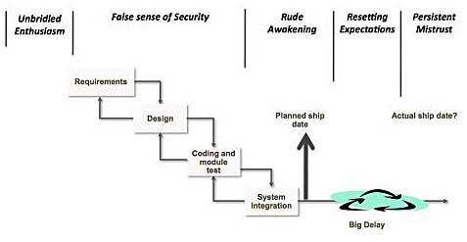
The five phases of disillusionment
Unbridled enthusiasm
A false sense of security
The rude awakening
Resetting expectations
The season of persistent mistrust

Slide 19
For Wednesday
Leffingwell Chapter 13
Read the CHAOS report

